Slide 1
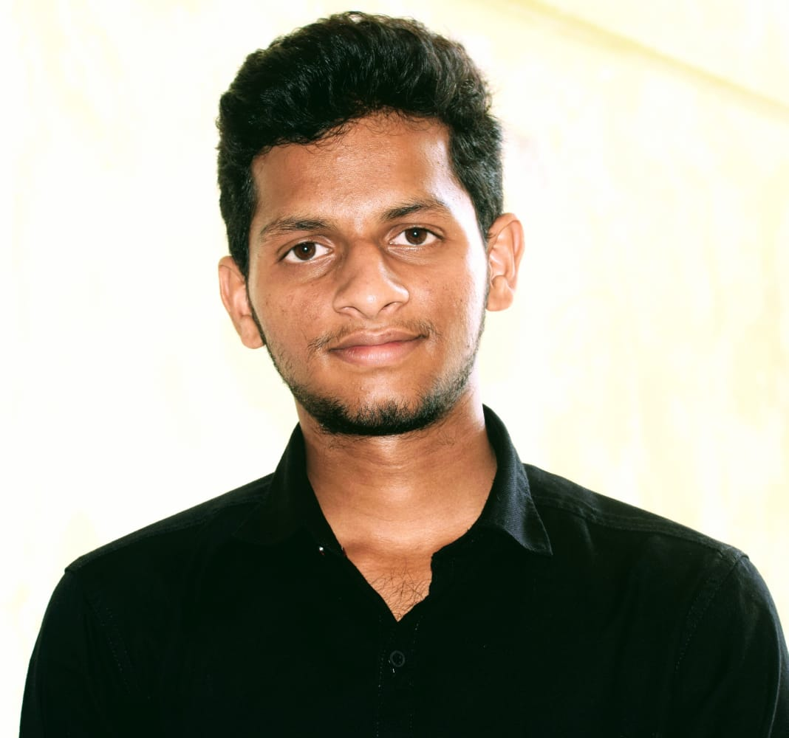


GUDI HARISH
Analyst/Software Engineer
BACHELOR OF TECHNOLOGY
Electrical and Electronics Engineering:2017-2021
Skills C#
Dot net core
Python
Advance Excel
Database
MS SQL Server 2014
SQL core
Web Technologies
HTML5
CSS3
AddOns
Github
Postman
Additional skills
Leadership Qualities
Quick Learner
Team Management
Good communication
BANGALORE
harish.gudi@capgemini.com
+91 9581068587
A4
Ability and flexibility to multi-task, prioritize, and organize multiple projects/ tasks concurrently while meeting project deadlines
Have better understanding on process agility and can come to up to speed on new technologies/ methodologies in best possible way
Able to deliver with zero defects products to customer with good development skills and interact with client with excellent communication skills
Open-Mindedness, Curiosity to learn new things and self Confident.
Recipe Ingredient Shopping :
Completed end to end case study of Recipe Ingredient Shopping along with JWT authentication, Swagger. html, CSS, JSused for user interface.
Check out my work on GitHub & Video Profile

